Slide 1
Paediatric Bladder and Bowel Care Service
Training and Education
Debbie Richards
Early Years Healthy Bladder and Bowel Educator
Paediatric Bladder and Bowel Care Service
Northern Devon Healthcare Trust

Slide 2

Nappy to Potty – A Parent and Practitioner Guide

Slide 3
Setting the Scene
Dealing with continence problems in school and early year’s settings can be difficult. Traditionally children were expected to be toilet trained before they could start in such provisions. However, toilet training is happening later now than in previous generations and schools report that increasing numbers of children are not toilet trained on admission.

Slide 4
Did you Know? ….
In the UK an estimated
900,000
or
1 in 12, 5 - 19 year olds
suffer from bowel and bladder conditions such as bedwetting, daytime wetting, constipation and soiling. (ERIC)

Slide 5
A New Milestone
Toilet training is like any other milestone in a child’s development
A child will achieve success when he/she is physically ready
There should be no pressure to train children unless the time is right
REMEMBER: Every child is different!

Slide 6
Ages and Stages
By the age of 3yrs, 9 out of 10 children are dry during the day.
By the age of 4yrs,most are reliably dry.
Between 4 and 5yrs,most learn to stay dry at night.
However, there are some exceptions, a delay in toilet training can happen for a number of reasons, including bladder or bowel problems, processing or sensory disorders, or disability.

Slide 7
Recognising The Signs of Readiness
Choosing the right time is sometimes not that easy. In partnership, work with parents to establish whether a child:
Has a good level of understanding and the ability to follow instruction and communicate
Has an ability to sit on the potty/toilet
Has an awareness of being wet or dirty
Has no signs of constipation
Can indicate when needing a wee
The gap between wetting is at least 1 - 1 ½ hrs

Slide 8
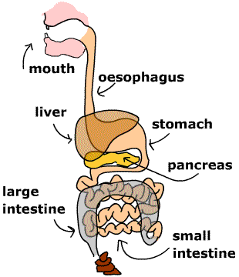
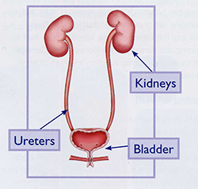
Healthy Bladder and Bowels

Slide 9
Healthy Bladder and Bowels
What do we mean?
For toilet training to be successful it is important that you check with parents to establish whether the child has a healthy bladder and bowel:
Things to check:
Can the child wee and poo without pain?
Can the child stay dry for at least an hour and a half between wees?
Can the child pass soft poos at least 4 times in one week?
Does the child consume sufficient drinks daily - at least 6-8 cups

Slide 10
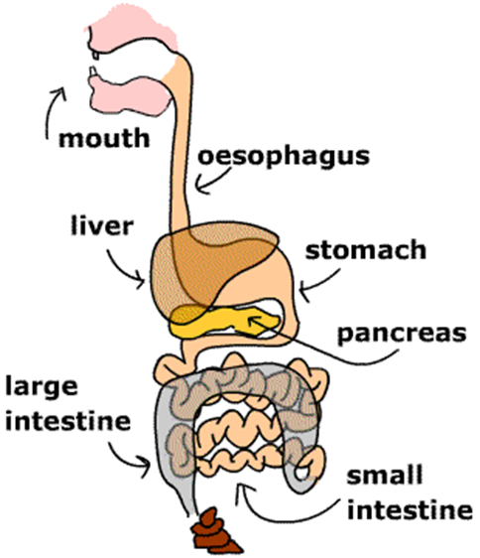
How a Healthy Bowel Works
The Poo factory!
Once eaten and chewed food enters the Stomach
The food then travel to the Small Intestine where the healthy nutrients re route to the rest of the body
The remains travel to the Large Intestine where strong muscles help the poo to travel along, the body soaks up the water content turning the poo into a smooth sausage shape.
The poo reaches the Bottom, sending a signal to the brain to alert us that we need to visit the toilet to pass a poo.

Slide 11

How a Healthy Bladder Works
The Wee Factory!
Like the body makes a poo after you eat/drink, it also soaks up the water and enters the bloodstream.
Blood pumps through the Kidneys which filters out what it doesn’t need – wee.
Wee travels down the Ureters into the Bladder
The bladder is a muscle. It fills up with wee and stretches, sending a signal to the brain to alert us that we need to visit the toilet to do a wee.
Wee travels out of the bladder through the Urethra and releases into the potty/toilet by relaxing the muscles.

Slide 12
Importance of Fluids
At the heart of all potty/toilet training it is essential that enough fluids are consumed on a daily basis.
Recommended intakes per day for children in your care are:
1 - 3yr olds: 900 mls
4 - 8yr olds: 1200 mls

Slide 13
Importance of Fluids
Not only is drinking enough fluids during the day important for maintaining healthy bladder and bowels but…….
dehydration can lead to lack of concentration, resulting in poor academic and sporting performance.
Think about ways to encourage good drinking habits for children in your care.

Slide 14
Importance of Fluids
You can organise drinks for all children in your care in the following way:
3 complete cups of drink at 3 intervals through day:
Mid Morning
Lunch
Mid Afternoon
Any additional fluids are a bonus and should not be discouraged.

Slide 15

Importance of Fluids
In order for a consistent approach to drinking fluids between home and school, It would be good practice for a child to bring a full clear drinks bottle to their setting/school each day.
The bottle should be marked into three sections. The child should be encouraged to drink…
Down to the first line at morning break
Down to the second line at lunch
The remainder at afternoon break.
200 mls
200 mls
200 mls

Slide 16
The Nappy Test
Once a good regular daily fluid intake routine has been encouraged and established, parents should carry out a nappy test to check for toileting readiness. They should be advised to:
Buy some good quality kitchen paper
Choose a free weekend to carry out the nappy test (across both days if possible)
Line each nappy with a folded sheet of kitchen paper
Check the nappy every 1 ½ hrs from the first change in morning and record whether it’s wet or dry
If the checks are more dry than wet it’s time to be brave and swap the nappy for cotton pants.

Slide 17
Why Pants not Pull Ups?
There is a tendency that parents make the transition from nappy to pants by using pull-ups. Please encourage them not to do so…
Cotton Pants
Are considerably less absorbent
Children will feel if they are wet
Are easy to pull up and down
Are cheaper to buy
Are washable
Pull Ups
Draw moisture away from body
Children will not feel if they are wet
Are difficult to pull up and down
Are expensive to buy
Are disposable
To bridge the gap to help a child to recognise the feeling of being wet a child can wear cotton pants under the nappy.

Slide 18
Being Prepared for toilet training
Have a discussion with parents and make a toileting plan for your setting.
Ensure there is consistency between home and setting.
A strong potty is required with a rigid base or use of a low level toilet.
Ensure parents dress their child in easy to get on and off clothing?
Be prepared for some accidents.
Ensure parents provide sufficient spare clothing.
Use the same language as parents to call wee and poo.

Slide 19
Let’s Go
If using a potty it should be placed in the setting toileting area. Ideally on a washable floor!
The potty/toilet should be accessible at all times for the child.
Encourage sitting on the potty/toilet after mealtimes for just a few minutes.
Engage children with story books about using a potty/toilet.
Consider incentives/reward for sitting on the potty/toilet not for just performing on it. Especially if parents are doing this at home.
Give gentle reminders and prompts.

Slide 20
Transition from Potty to Toilet
Sitting on the toilet is the next step after sitting on a potty. For most it will be a natural progression. For others it won’t be so easy. Things to consider:
Provide a step to…
Help your child get on to the toilet.
To provide a good base for their feet. (Important for pooing)
Consider…
Fitting a child’s toilet seat inside the standard seat to provide security and stability.

Slide 21
Needing a Nappy to Poo
Some children feel more secure to do a poo in a nappy.
Consider the following to change this:
Ensure nappies are kept in the bathroom.
Most likely, your child will have a regular time to do a poo. Try to encourage him/her to sit on the potty at this time with or without wearing a nappy.
If wearing a nappy, gently see if he/she will let you remove the nappy or loosen the tabs.
If able, remove the nappy and line potty or toilet with it to catch the poo.
If really reluctant, you could make a hole in the nappy, so the poo can drop through.
Involve your child in emptying the nappy contents down the toilet and flushing the poo away.

Slide 22
Children with Additional Needs
Toilet training for children with additional needs can be done in much the same way as teaching a child without additional needs, provided that there is not a physical reason for not being able to sit on a potty or toilet. It just might take a little longer in some cases.
Things to consider:
A child with additional needs is not always able to communicate their thoughts and feelings. Therefore you might not be able to rely on their signals to tell you when they’re ready to potty train.
Get to know and record how often the child goes for a wee or poo to help decide regards readiness.
Create a potty or toilet routine based on the information you have recorded.
As with a child without additional needs, it is really important to ensure he/she feels relaxed, comfortable and secure about using a toilet or potty. It might be necessary seek advice from an Occupational Therapist who can advise which support is best whilst toilet training.

Slide 23
Recap
Encourage children in your care to drink at least 3 cups of fluid per day whilst in your care.
Everything should take place in the toileting area.
Try changing children being trained whilst they stand, rather than lying them down.
Encourage boys to sit not stand whilst toilet training
Communicate with parents regards progress.
Be consistent, keep calm, keep positive. There will always be accidents!

Slide 24
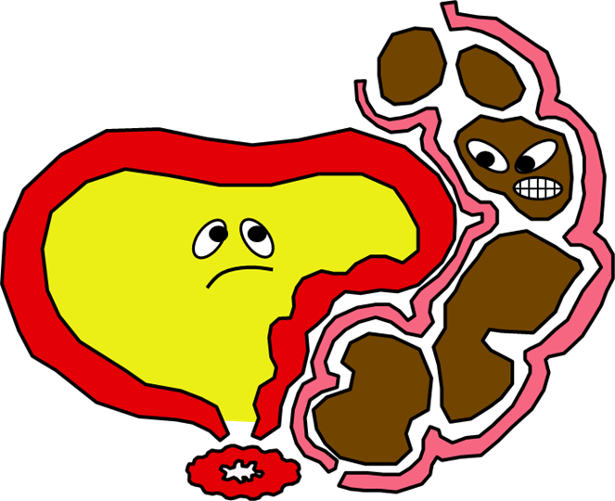
When all goes wrong….
The consequences for a child when toileting goes wrong can mean….
Constipation
Day time wetting
Night time wetting
Repetitive Urinary Tract Infections (UTI’s) which can lead to significant renal damage
Failure to treat will impact hugely on a child’s self esteem, education and social relationships

Slide 25
The Referral Pathway
Working together with parents is essential for toilet training to be achievable for any child. Should a child be identified as having a continence issue, the referral pathway is as follows:
Any child registered with a GP practice in North, East, South Devon and Torbay…..
Level 1 (Basic) – Practitioners working at a community level (GP’S, Public Health Nurses, Early Years settings and schools) to provide basic diet and fluid information, help with behaviour and signpost to ERIC website.
If no further progress is made then a child should be referred directly into the Paediatric Bladder and Bowel Service….
Level 1 (Enhanced) – A child will be offered a full bladder and bowel baseline assessment and first line treatment appropriate to need.
Level 2 - If continence issues remain unresolved within 3 to 6 months at Level 1 (Enhanced) a child will be seen within the service at this level.
Any Child registered with a GP Practice in Plymouth who requires a referral should be seen by their GP and referred into the Bladder and Bowel Service provided in that locality.

Slide 26
Helpful Info….
Contact your Health Visitor/School Nurse.
OR
Take a look at these useful websites and podcasts:
www.eric.org.uk
www.bbuk.org.uk
Film 1 – The Importance of Fluid Intake is https://youtu.be/WyLBntO9FQQ
Film 2 – Bladder Control & Potential Problems is https://youtu.be///OzD6nBe-mYI
Film 3 – Bowel Control & Potential Problems is https://youtu.be/lKh9PgzeDyg

Slide 27
Contacts
Public Health Nursing Hubs
(Health Visiting/School Nursing):
SOUTH: 0333 234 1901
EXETER: 0333 234 1902
EAST: 0333 234 1903
NORTH: 0333 234 1904
TORBAY: 0300 333 5352
Paediatric Bladder & Bowel Care Service:
Tel: 01392 208044
e-mail: ndht.pbbc@nhs.net

Slide 28

Thank you for Listening

Slide 29
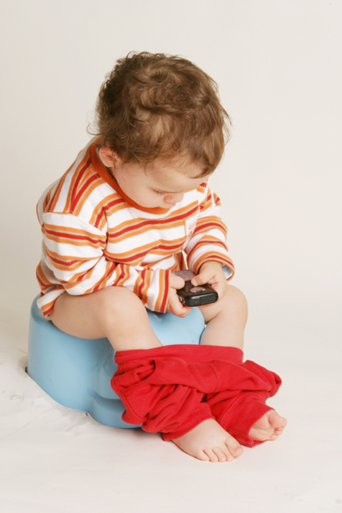

Any Questions?

