Slide 1
UNICEF/Helin

Slide 2
What do you need to be healthy?
How many ideas can you think of to help you be healthy?
Write them down and then compare your answers with the next slide.

Slide 3
How many of these did you get?
Enough Sleep – at least 8 hours
Nutritious Food – fruit and vegetables
Water – at least a litre a day
Good hygiene – keeping clean, particularly your hands
Exercise
A clean environment
Feeling safe, secure and respected
Health care - To see a doctor or a nurse when you need to and to be vaccinated against diseases

Slide 4


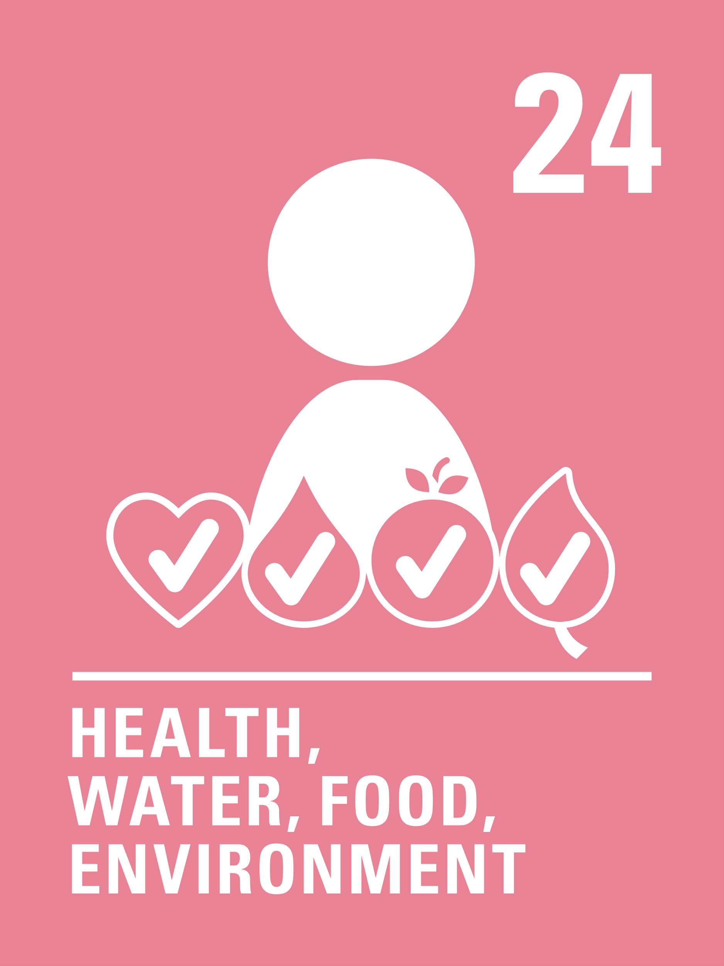


Activity time
Draw or list people who can help you stay healthy and safe. What are their jobs?
Make a list with words or pictures of as many kinds of exercise you can think of.
All these activities are related to…
Set up an obstacle course and challenge someone in your house to have a go.
Read Coronavirus: a book for children and talk about what you are doing as a family to keep healthy during this time.
You don’t need to do every single activity but if you have time you can do more than one.
Primary

Slide 5


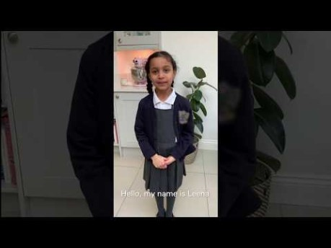

Activity Time
The new hospitals being built are called Nightingales. Who are they named after and what did this person do to enable the right to good quality healthcare?
Have you taught your family to wash their hands carefully? Watch this video on YouTube.
Could you create your own video linked to Article 24?
Invent a recipe for a healthy snack that you could make for your family.
Choose 10 items of food from your kitchen, can you sort them into healthy/not so healthy?
Primary

