Slide 1
Notes:
December 2019. A youth activist from Zimbabwe, participates in a panel discussion during the High-level Event on Climate Change and Children Rights, part of the 2019 UN Climate Change Conference (COP 25) in Madrid, Spain. The event, held under the title “We Dare: Children and Youth vs. Climate Change”, included the participation of adolescents and ministers from different countries. As part of the event, countries were invited to sign the Intergovernmental Declaration on Children and Youth in Climate Action.

Slide 2
What do you need to be heard?
What sort of things need to happen if you are to get your voice heard properly?
What would help you? What should adults do?
Write them down and then compare your answers with the next slide.

Slide 3
How many of these did you get?
Being properly listened to
Information about the situation so that you can comment properly
Help to communicate your ideas if you need it
An invitation or opportunity to give your views in a way that works for you
Feed-back so that you know your views have been heard
Feeling that your voice counts
Trusting that you can speak honestly even if your opinion is different from many others
Believing that your opinion is welcome and respected

Slide 4


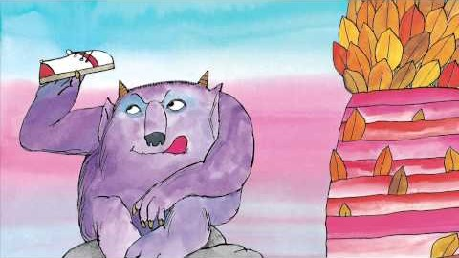


Activity Time
In some stories children’s views are ignored. Have you read ‘Not Now Bernard!’? If not watch this story. What would you say to Bernard’s parents if you had the chance?
All these activities are related to…
Can you think of any stories or films in which children’s voices are really listened to and it makes a difference? If you think of one, tell somebody about it.
Write to your headteacher or your School Council with your ideas about the learning activities being set for you. Explain the things you find helpful and suggest things you might like to do differently.
Design a poster for display
about the importance of
Article 12.
You don’t need to do every single activity
but if you have time you can do more than one.
Primary

Slide 5


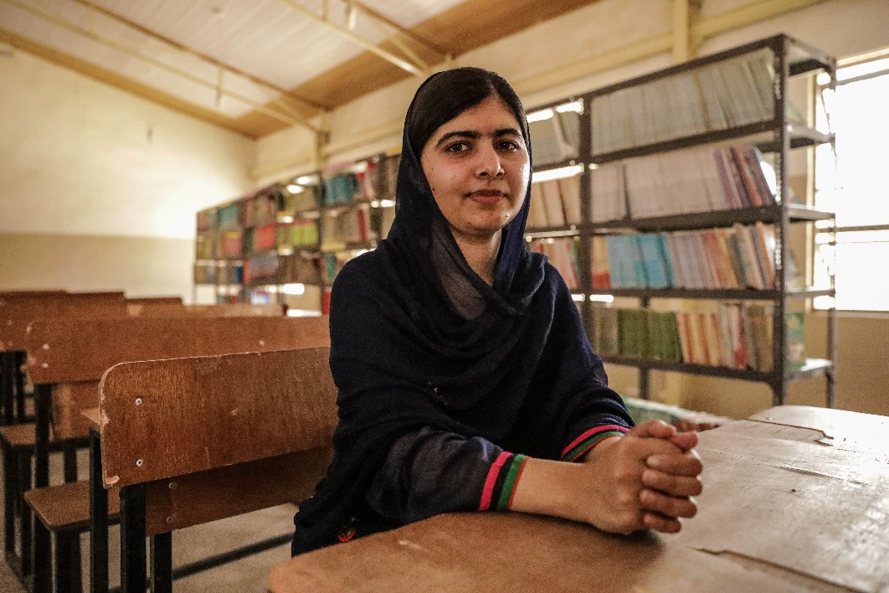
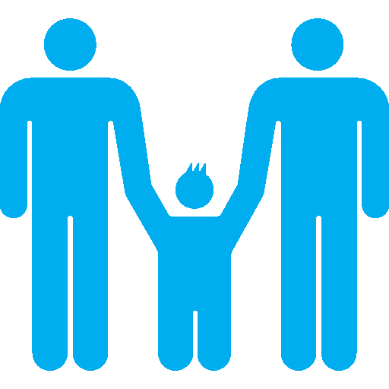
Activity Time
Find out about a child or young person who made sure their voice was heard. You could choose Malala Yousafzai or Greta Thunberg or see if you can find out about somebody less well known.
Write a creative story, a poem, a short play script or a piece of art using the title ‘Head My Voice’. Share it with your teacher and class.
.
Have you ever thanked people at home who are good at listening to you? Design a card or picture, or write a letter to thank them for hearing your voice.
Are you familiar with organisations such as Childline and YoungMinds which support young people to express their views, concerns and worries. If not, spend a while exploring their website, you might find some of the guidance interesting or helpful. Think about sharing this information with your friends.
UNICEF/Abubakar
Primary

Slide 6


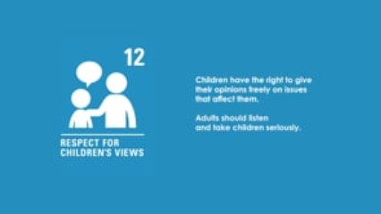

Activity time
Find out how your school is listening to students’ opinions and views during this time of school closure.
This short film was made by a Scottish charity called ‘Families Outside’. It helps explain why Article 12 is important. Watch now.
These activities will help you understand how...
…can relate to your life. You don’t need to do every activity, just do as many as you can.
If you were to stand for election to your School Council or Pupil Parliament next year what would you say in your speech or manifesto? Start drafting it now!
After you have watched the short film write down three reasons why children's opinions should be taken seriously by adults.
Secondary

Slide 7



Activity time
Has your school shared websites for organisations which support young people to express their views and concerns? If not, spend some time researching these organisation to see if they have any helpful guidance and share that with your class.
"It’s important that young people’s voices aren’t overlooked"
The Unicef Youth Advisory Board have written an open letter asking the UK Government to directly address children in a special coronavirus broadcast.
Will you help them by adding your name? unicef.uk/open-letter
Visit the Unicef Voices of Youth home page and find out more about your voice can join with young people all over the world.
Find a song, poem or short video about the importance of being listened to and share with your friends, your family, your teachers.
Carry out a short research project about young activists who have made their voices were heard. Start by reading profiles of youth activists - from page 28 of our 2019 OutRight pack - then find out more about them through online research and present your findings to your teacher in a two page report.
Secondary

Slide 8
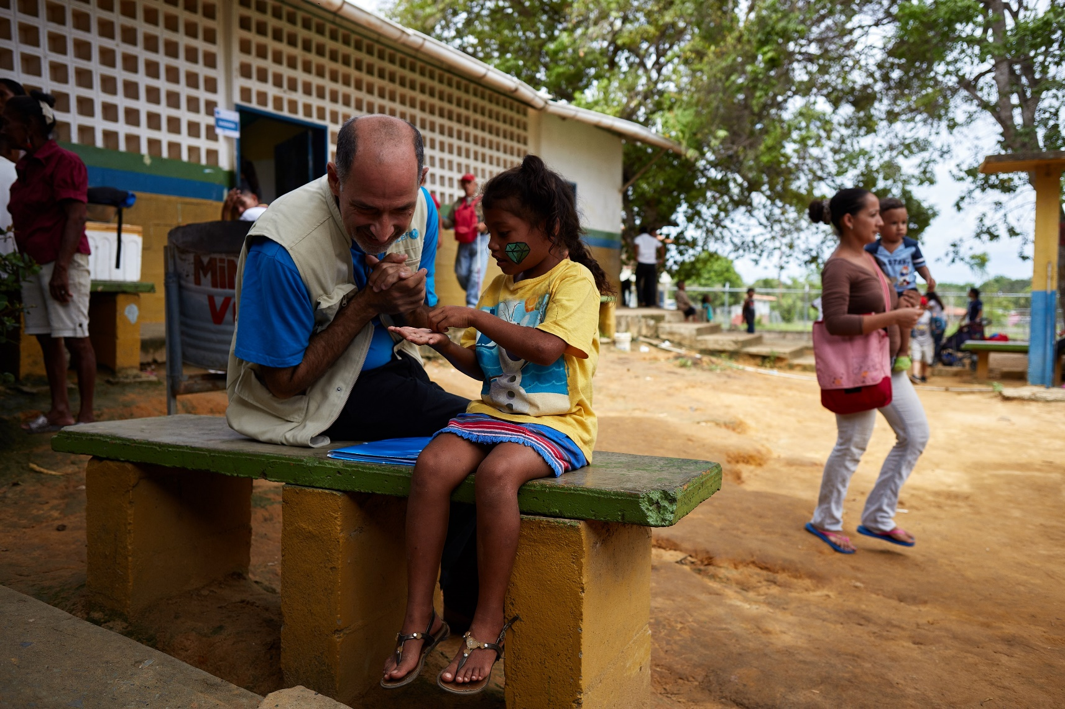
Reflection
Spend a few minutes thinking about these questions.
Try to find somewhere quiet for a few minutes, sit comfortably and be as still as you can… just try to relax… and listen to the sounds, within your body, close by and further away. Try this short guided meditation.
How does it feel when you know that an adult has really listened to you?
How can we show our appreciation and why is this important?
How can we respect other people’s right to have their voice heard? Even when we disagree?
Ask yourself – what could I do to make my voice stronger? What should I really speak up about? How can I do this?
Write down your answers or talk to people in your home.
UNICEF/Montico

