Slide 1


The power of giving

Slide 2


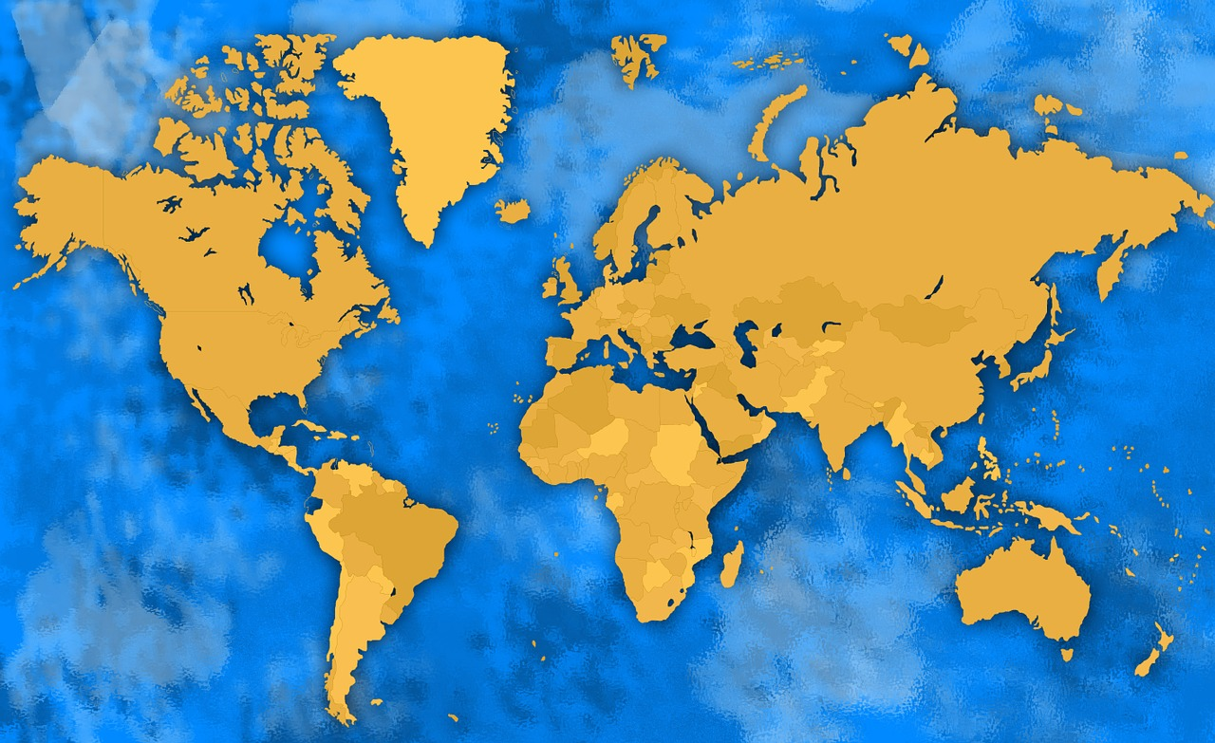

This story is adapted from an old Japanese folktale.
2
© Young Citizens

Slide 3

There once was a poor young man named Shobei who worked very hard as a farm labourer.
One day, the weather was boiling hot and he was so tired after work that he stumbled as he walked down the steep path back to his home.
3
© Young Citizens

Slide 4
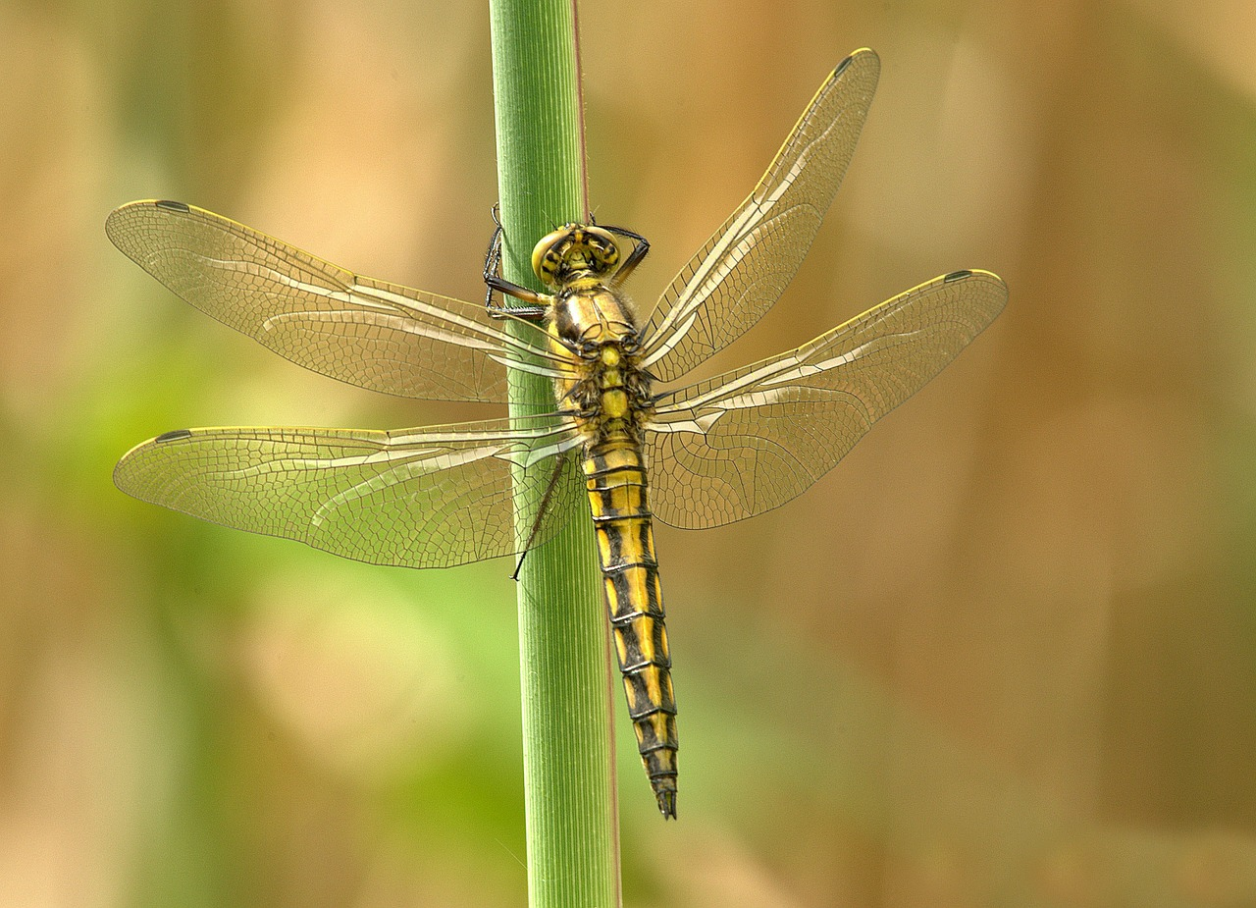
As he picked himself up, Shobei noticed that he had pulled up a blade of grass.
Perched on the end of the grass was the most beautiful shimmering dragonfly.
He shook the grass, expecting the insect to fly away – but it clung to the blade, and didn’t move.
4
© Young Citizens

Slide 5
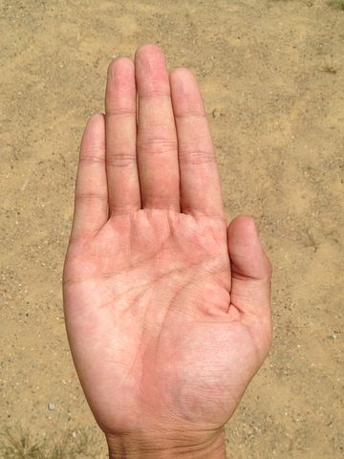

As Shobei watched the dragonfly, a mother and her small son walked past.
‘Mummy, mummy!’, cried out the little boy, ‘Please can I look at the beautiful shiny fly?
Without stopping to think Shobei said, ‘Of course you can!’ and he gently handed the blade of grass to the little boy on which the dragonfly sat.
5
© Young Citizens

Slide 6

‘That’s so kind of you!’ exclaimed the little boy’s mother. ‘Here, take these in exchange.’
She handed Shobei some juicy, ripe oranges which she had just bought in the market.
Shobei thanked her for her kind gift, and carried on his way.
6
© Young Citizens

Slide 7
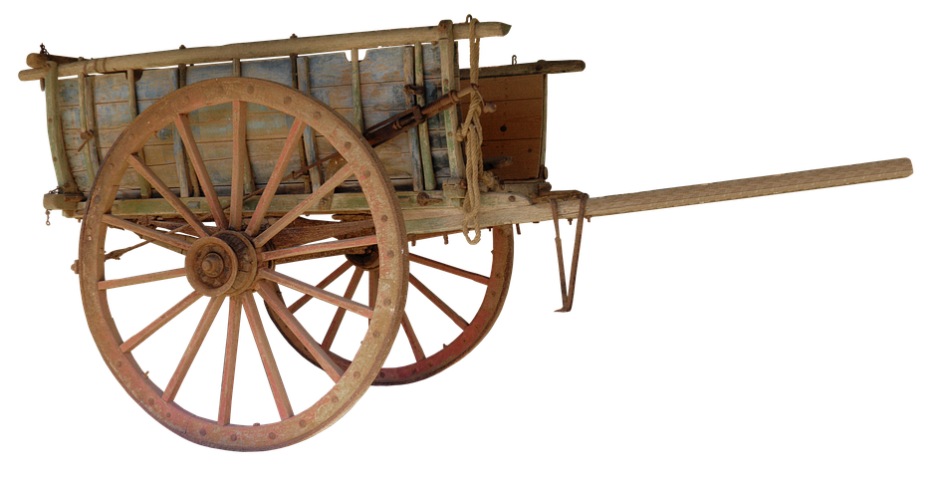
Before long he passed a merchant staggering up the hill in the opposite direction.
He was weighed down by his heavy cart which was filled with expensive silk cloth.
‘You look as if you could do with something to refresh you.’ said Shobei, ‘Here, have as many oranges as you like’.
7
© Young Citizens

Slide 8
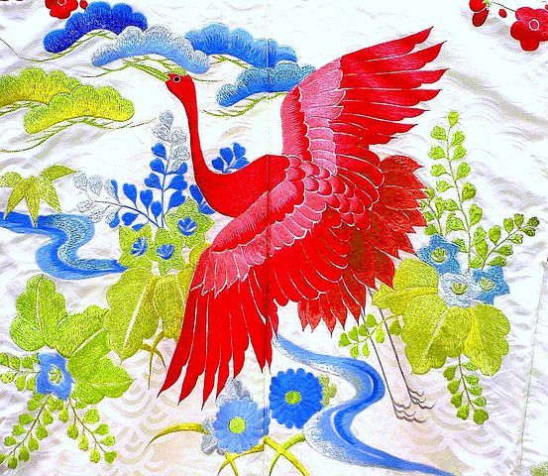
The merchant was very grateful to rest and enjoy a juicy orange.
‘How very kind of you’, said the merchant. ‘I would like to repay your generosity with one of my best pieces of cloth.’
Shobei accepted the gift with thanks and continued on with the magnificent piece of embroidered silk slung over his shoulder.
8
© Young Citizens

Slide 9

Suddenly the ground began to tremble beneath his feet and Shobei heard the clatter of wheels, and the clip-clop of horses’ hooves.
A magnificent carriage drove up and stopped in front of Shobei.
A guard jumped down from the carriage and ordered Shobei to come to closer.
9
© Young Citizens

Slide 10
To his astonishment when he looked inside the carriage, he saw the beautiful Princess Lotus Flower, the Emperor’s daughter.
‘I couldn’t help noticing that beautiful cloth you are carrying. Would you sell it to me please?’
‘No ma’am, I wouldn’t dream of selling it to you …. But I would be delighted to give it to you as a present!’ said Shobei.
10
© Young Citizens

Slide 11


‘You are extremely generous’ said the princess, ‘but I couldn’t accept such a gift without paying for it.’ She handed Shobei a small bag and then the royal carriage moved on.
When Shobei opened the bag, he couldn’t believe his eyes. It was full of bright new glistening gold coins!
Shobei ran home as fast as he could. He was desperate to tell his family and friends about his good fortune.
11
© Young Citizens

Slide 12

On returning home, Shobei called all his friends and family to a meeting.
He told them his great news and said that he planned to use the money to buy lots of farmland.
He explained that it was his wish that they would all share this land.
12
© Young Citizens

Slide 13

Shobei and his family and friends worked hard to farm the land he bought for them all.
They grew many crops and built wonderful homes with the money that they made selling their crops at the market.
13
© Young Citizens

Slide 14
And it all began with a single dragonfly on a blade of grass!
14
© Young Citizens

Slide 15
Talking Time
Q. Did Shobei deserve the money?
Q. What have people thanked you for doing?
Q. How can you thank people who are kind to
you?
15
© Young Citizens

Slide 16

Talking Time
Shobei chose to share the land that he bought with his friends and family.
Q. Do you think this ///was a good ///decision?
Why?
16
© Young Citizens

Slide 17


Challenge 1:
Order the story using the pictures provided on The Power of Giving worksheet.
Challenge 2:
Shobei’s first act of generosity was giving a little boy a chance to see a dragonfly.
Use our template to make your own dragonfly as a reminder that simple acts of generosity can lead to great things.
17
© Young Citizens

