Slide 1


Tongue-
The power of words

Slide 2

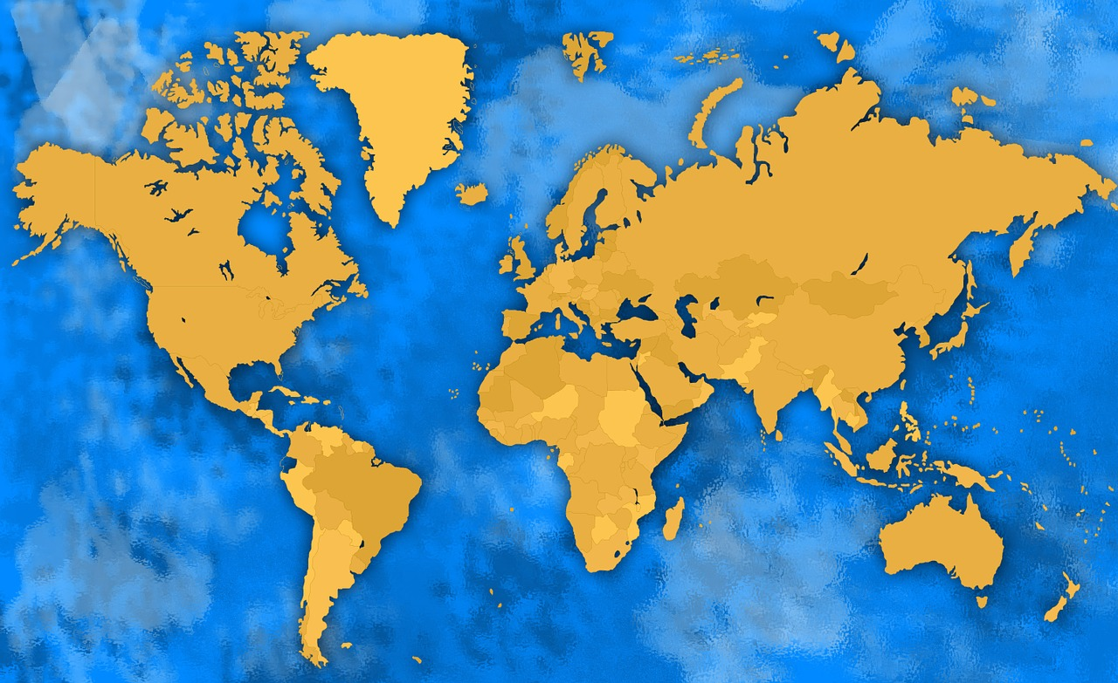

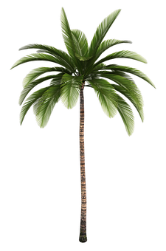
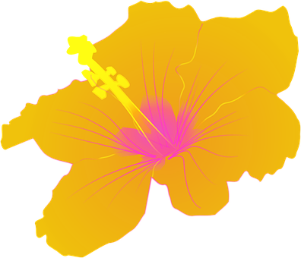
This story is adapted from a West Indian Carib legend.
2
© Young Citizens

Slide 3

The Carib people lived in the Caribbean islands long before they were visited by Europeans such as Christopher Columbus.
The Caribs believed that there were many Gods.
This traditional tale is about Obatala, who was said to be the most powerful of all the Gods.
3
© Young Citizens

Slide 4
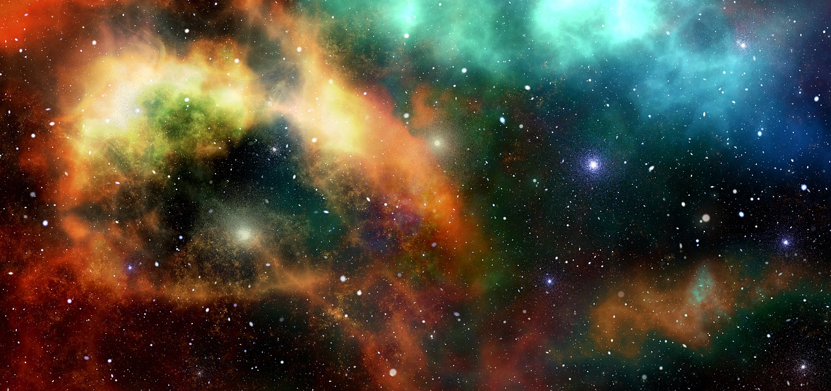
Obatala ruled across the entire universe.
It was a huge responsibility, so he decided to choose another god to be his special helper.
4
© Young Citizens

Slide 5
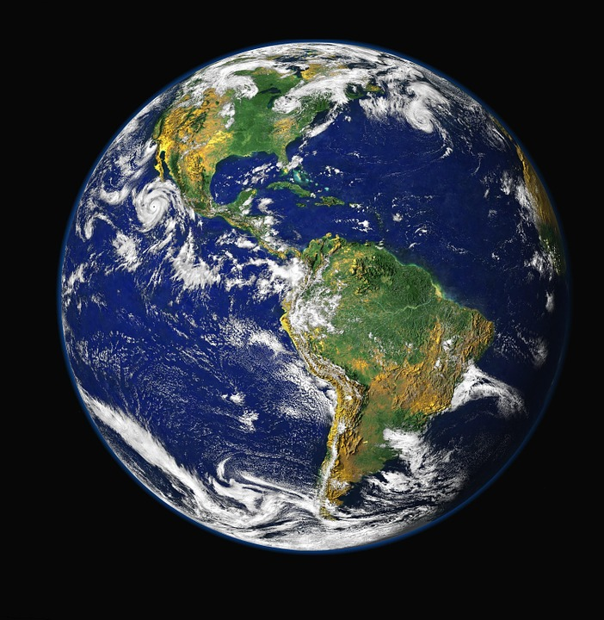
Planet Earth was the most difficult of all the planets to rule.
This was because of the human beings who lived on Earth.
Obatala thought that humans were the most challenging creatures in the whole universe!
5
© Young Citizens

Slide 6
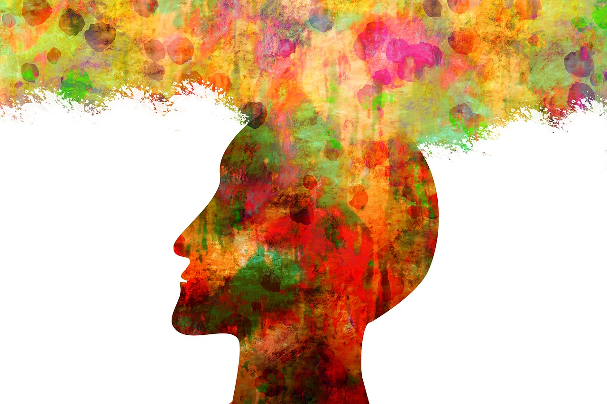
Obatala believed that the god Orula might be a good helper.
Orula was known to be thoughtful and wise.
However, before Obatala gave Orula responsibility for planet Earth, he thought that he would set him a test.
6
© Young Citizens

Slide 7

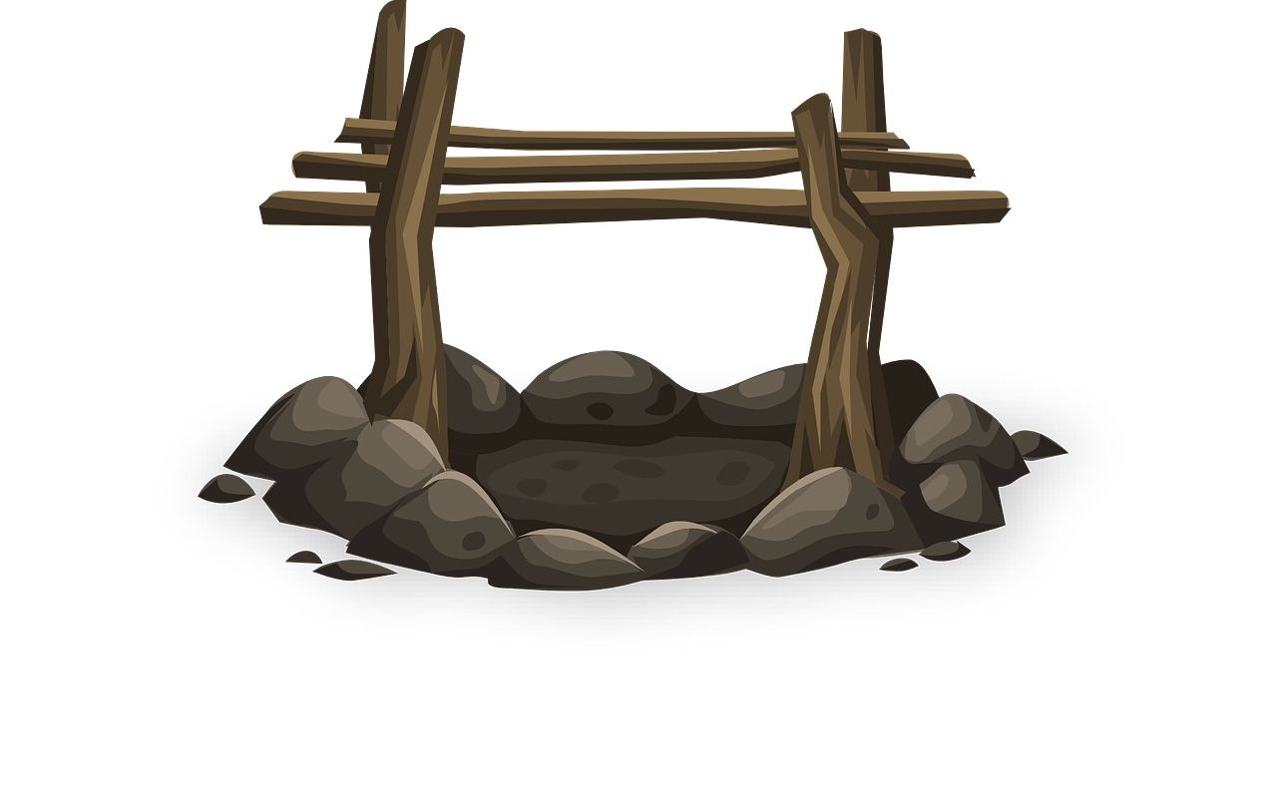

Obatala ordered Orula to cook him the most delicious meal he had ever made.
Some hours later Orula returned with a plate of ox tongue.
Obatala tasted it, and found it to be the most delightful meal he had ever eaten.
7
© Young Citizens

Slide 8


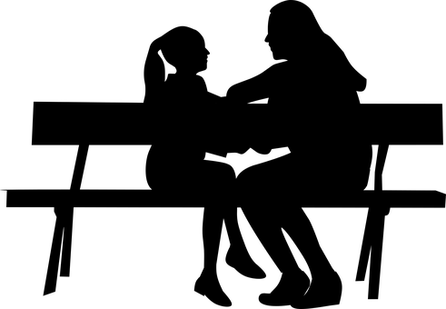
‘Tell me, why did you choose tongue?’ asked Obatala.
‘A tongue can do so much good’ replied Orula.
‘It can speak words of love and kindness. It can tell jokes that make people laugh and it can give comfort to those in pain.’
8
© Young Citizens

Slide 9
Obatala smiled, he was very pleased with Orula’s answer.
‘Next I would like you to cook me the worst meal you have ever made.’ commanded Obatala.
Orula bowed, then left.
9
© Young Citizens

Slide 10
A little while later Orula returned.
He was carrying what looked like the same dish that he had already served Obatala.
Once again, Obatala took a small piece to taste.
10
© Young Citizens

Slide 11
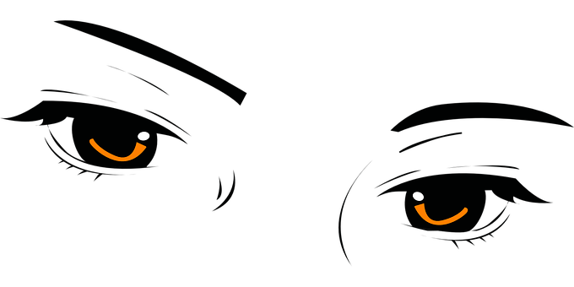



‘Urgh, that’s absolutely disgusting. I don’t understand how the same food could taste so bad!’ cried Obatala.
‘A tongue can do good but it can also do terrible evil.’ said Orula.
‘A tongue can spread lies, and cause immense pain if it says cruel words. It can even lead people to do wicked things.’
11
© Young Citizens

Slide 12
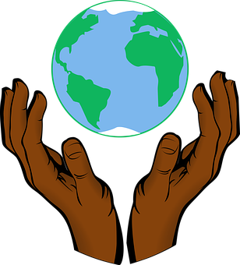
‘You have shown me that you have great wisdom’ said Obatala.
‘I will make you the ruler of Earth, for there you will find human beings with tongues that can do great good or terrible evil.
Guide them to make the right choices so they can lead a happy life.’
12
© Young Citizens

Slide 13
Talking time
Q. Why did Obatala want
someone to help him rule Earth?
Q. What test did Obatala give ///Orula?
Q. Why did Orula say a tongue can ///do so much good?
Q. Why did Orula say a tongue can ///do so much evil?
Q. Why did Obatala think humans ///needed Orula’s help?
13
© Young Citizens

Slide 14

Challenge:
Create a tongue twister to teach others the power of words.
Use our worksheet to help get you started.
14
© Young Citizens

