Slide 1


Sira’s Story

Slide 2

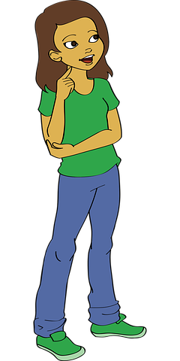
Q. Can you think of a time ///when you have been ///annoyed about a rule?
Listen to the story of Sira and her frustration with following rules.
2
© Young Citizens

Slide 3



3
© Young Citizens

Slide 4


4
© Young Citizens

Slide 5


5
© Young Citizens

Slide 6

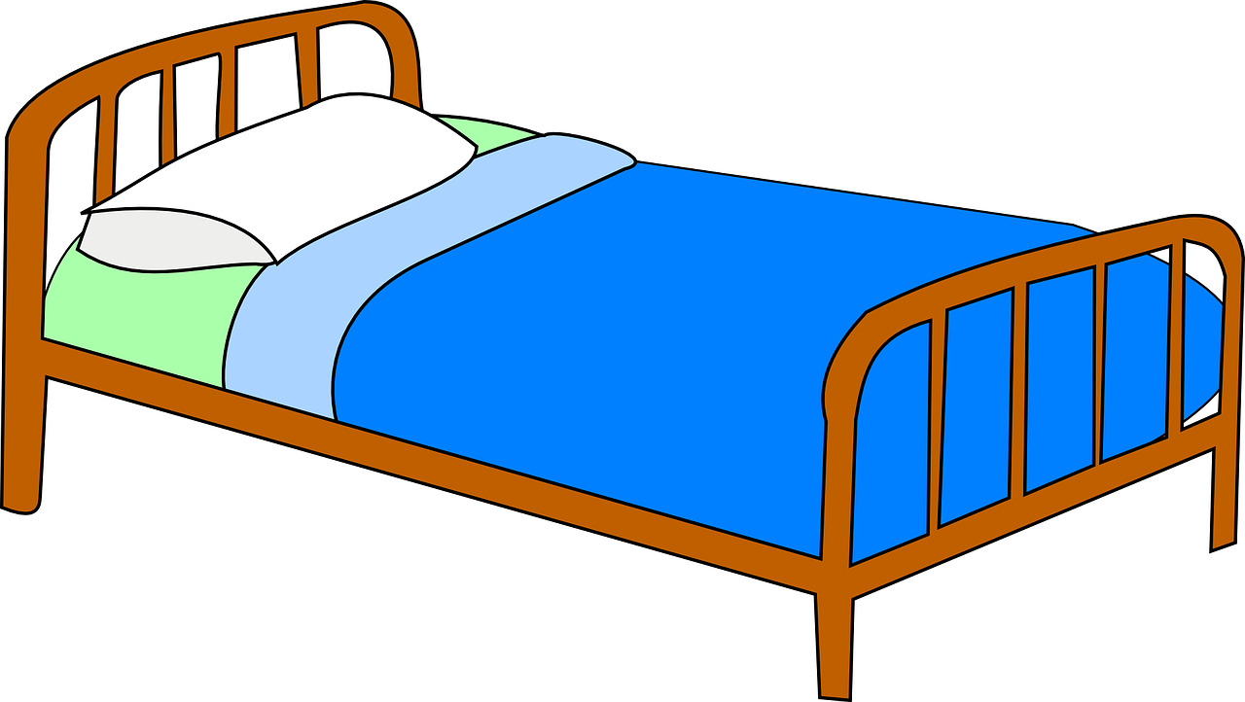
6
© Young Citizens

Slide 7




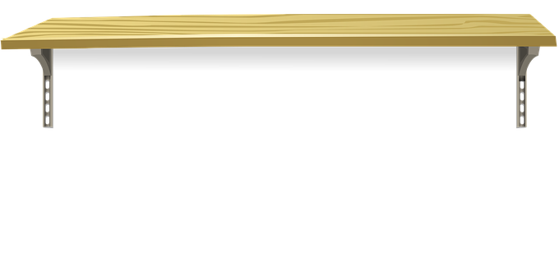


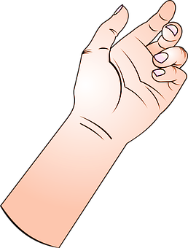
7
© Young Citizens

Slide 8

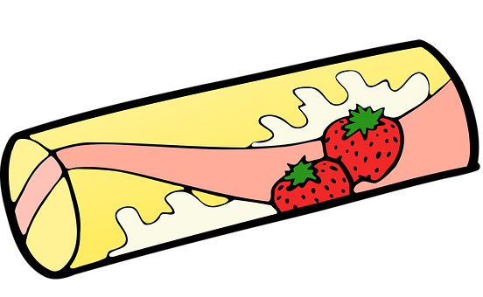


8
© Young Citizens

Slide 9

9
© Young Citizens

Slide 10

10
© Young Citizens

Slide 11


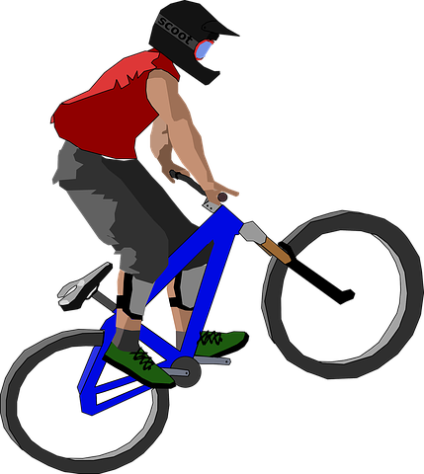
11
© Young Citizens

Slide 12


12
© Young Citizens

Slide 13

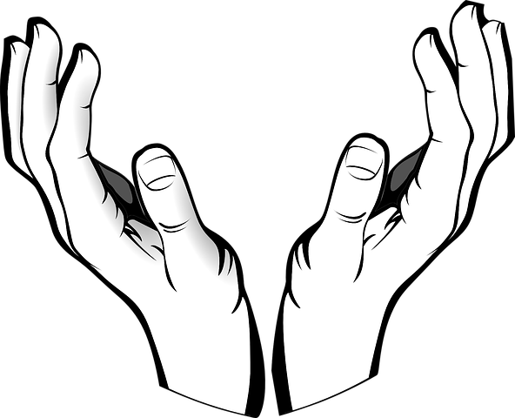
13
© Young Citizens

Slide 14
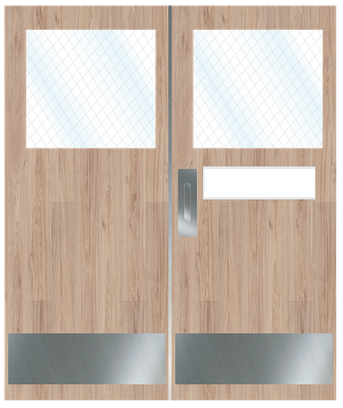

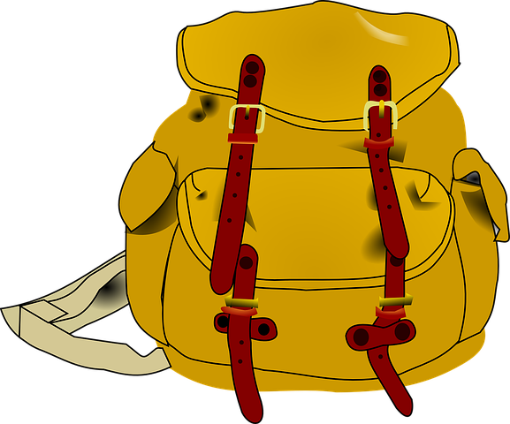


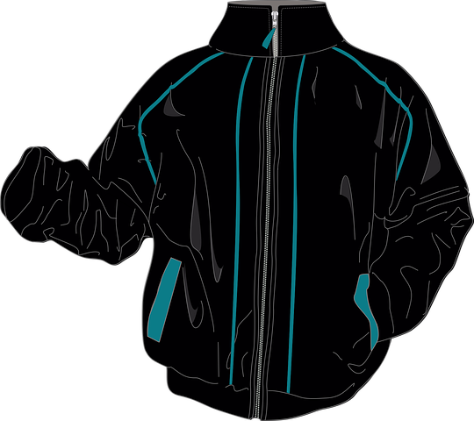

14
© Young Citizens

